Slide 1

Participant Details
Participant Name: Yasmeen Begum, Km Mahak gupta
Problem Statement:AI-Powered Online Threat Detection System

Slide 2
Brief about the idea
This project is an AI-powered system designed to detect harmful or threatening messages in real time.
It focuses on improving online safety, especially for users facing harassment or cyber threats.
The system uses LangChain with Google Gemini to analyze and classify messages.
Messages are categorized as Safe, Suspicious, or Dangerous with clear explanations.
An MCP-based agent enables the system to automatically take intelligent actions.
It can send alerts, store evidence, and trigger emergency responses without manual intervention.
RAG with ChromaDB is used to maintain context and detect repeated threats.
The system stores harmful messages securely in a database for future reference.
It sends real-time WhatsApp alerts using Twilio.
Overall, it combines AI, automation, and real-time communication to enhance digital safety.

Slide 3
Approach to the Problem Statement
We started by identifying the key issue: online harassment and threats are difficult to detect early and act upon in real time.
To solve this, we translated the problem into an AI pipeline that can analyze messages, classify risk levels, and trigger automated actions instantly.
We used LangChain with Google Gemini to handle intelligent text understanding and reasoning.
To meet hackathon requirements, we ensured the system includes real-time processing, explainability, and actionable outputs (alerts + storage).
We also integrated MCP-based agents to make the system autonomous and decision-driven instead of rule-based.

Slide 4
Real-World Problem & Impact
Our solution addresses the growing issue of cyberbullying, online harassment, and threatening communication, especially targeting vulnerable users.
Many victims fail to act early because threats are subtle or continuous over time.
This system provides early detection and immediate alerts, helping users stay aware and safe.
It also creates a secure record of harmful messages, which can be useful as digital evidence.
The practical impact is improved personal safety, faster response to threats, and increased trust in online platforms.

Slide 5
Core Approach / Workflow
The system works in a structured pipeline:
User inputs a message through the interface.
The message is analyzed using LangChain + Gemini for classification and explanation.
An MCP-based agent evaluates the result and decides actions.
If the message is dangerous, the system:
Sends alerts via Twilio
Stores evidence in the database
Triggers emergency API (simulated)
RAG (ChromaDB) is used to maintain context and detect repeated threats.

Slide 6
How is it Different from Existing Solutions?
Most existing systems focus only on basic keyword filtering or static ML models, which miss context and subtle threats.
Our solution uses LangChain with Google Gemini, enabling context-aware and reasoning-based detection.
Unlike traditional systems, it includes RAG (memory) to detect repeated harassment patterns over time.
It also goes beyond detection by providing automated actions like alerts, storage, and escalation.
Additionally, the use of MCP agents makes the system dynamic and decision-driven, not just rule-based.

Slide 7
Features offer by the Solution
Real-Time Threat Detection – Instantly analyzes messages to identify harmful or abusive content.
AI-Based Classification – Uses LangChain with Google Gemini to classify messages as Safe, Suspicious, or Dangerous.
Explainable AI – Provides clear reasons for why a message is flagged as harmful.
MCP-Based Intelligent Agent – Automatically decides and performs actions like alerting and storing data.
Context-Aware Detection (RAG) – Uses ChromaDB to track message history and detect repeated threats.
Instant WhatsApp Alerts – Sends real-time alerts using Twilio.
Secure Evidence Storage – Saves flagged messages in MongoDB with timestamps for future use.
Automated Response System – Triggers alerts and actions without manual intervention.
User-Friendly Interface – Interactive UI built with Gradio for easy usage.
Scalable API Integration – FastAPI backend enables integration with web and mobile applications.

Slide 8
Technologies Used
Programming Language: Python
AI & LLM Framework: LangChain
LLM Model: Google Gemini
Agent Framework (MCP): LangChain Agents (Model Context Protocol approach)
Vector Database (RAG): ChromaDB
Embedding Model: Sentence Transformers (MiniLM)
Backend Framework: FastAPI
Frontend/UI: Gradio
Database: MongoDB
Alert System API: Twilio (WhatsApp alerts)
Environment Management: python-dotenv
API Communication: Requests (HTTP calls for emergency API)

Slide 9
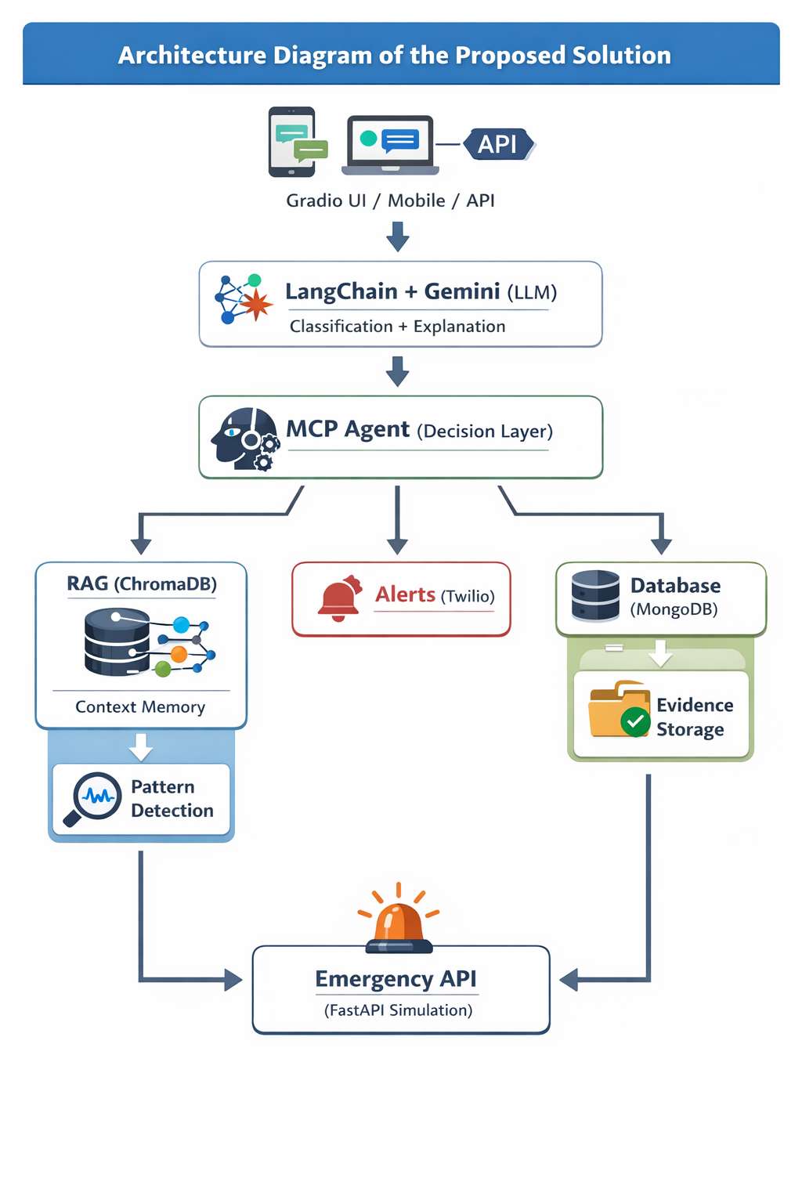
Architecture diagram of the proposed solution

Slide 10
Component Explanation
1. User Input Layer
Input from Gradio UI, mobile app, or API
Sends message to AI system
2. AI Processing Layer
Uses LangChain with Google Gemini
Performs classification (Safe / Suspicious / Dangerous)
3. MCP Agent (Decision Layer)
Decides what actions to take
Calls tools dynamically (alerts, storage, reporting)
4. RAG Layer (ChromaDB)
Stores past messages
Retrieves similar messages
5. Alert System
Sends real-time notifications via Twilio
Notifies users instantly
6. Database Layer (MongoDB)
Stores flagged messages
Keeps timestamps for evidence
7. Emergency API Layer
Handles high-risk cases

Slide 11
Thank You

